Slide 1
The Seven-Years’ War
The American Pageant
Chapter 6

Slide 2
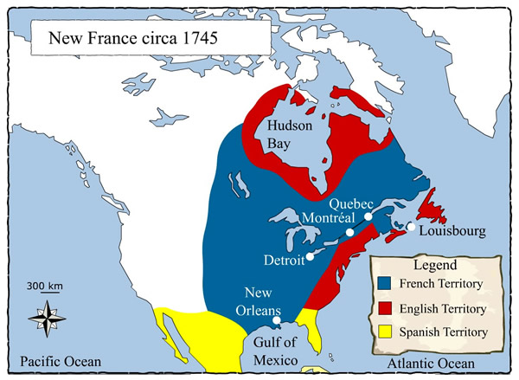
This Land Ain’t Big Enough For The Two Of Us
Important to note that France and Spain do not have as many people as the English; they do have the same motives, though!
Two main powers in North America: France and England
Ohio Territory is critical for France
Connects Canada to Louisiana/Mississippi Valley
England feels “threatened” economically
France taking land; business practices

Slide 3
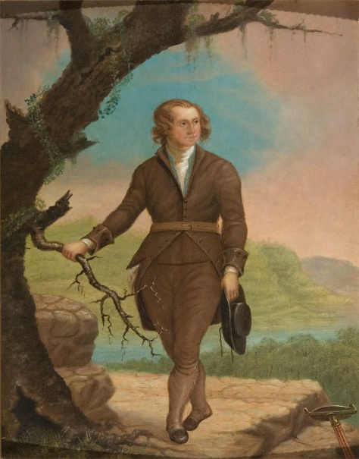
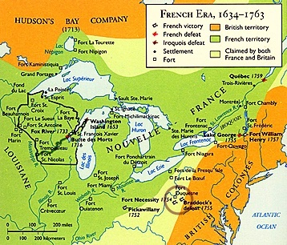
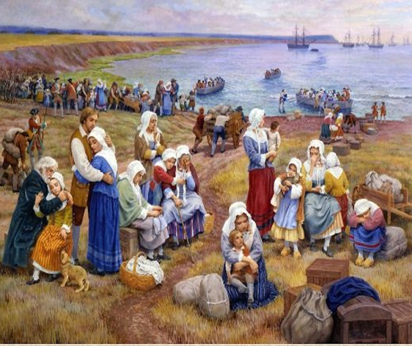
Disputed Territory
1749—tensions are high
British speculators (Virginians) secured legal rights to land
The French are setting up Forts/posts in same region (British, too)
Fort Duquesne (Ohio)
Monongahela and Allegheny Rivers
George Washington sent to Ohio Country / Valley
150 men
Washington’s men fire first on French
French retreat, Washington wins…for now
French come back with reinforcements
Fort Necessity (Ten Hours)
Washington forced to surrender (1754)
Further distrust among each nation
Displacement of French Acadians from Nova Scotia

Slide 4
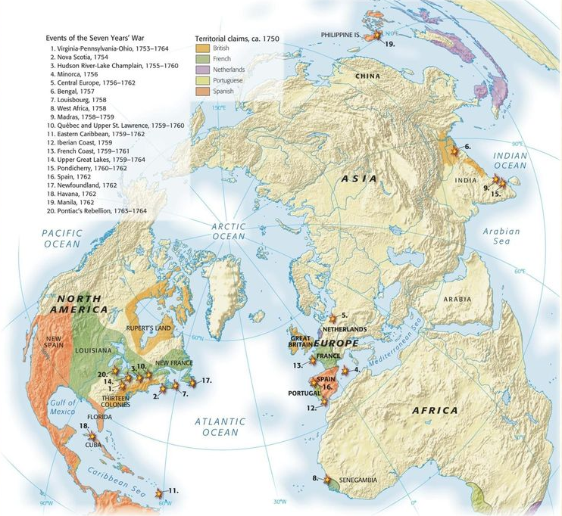
Global War; Colonial Disunity
King William’s War; Queen Anne’s War; King George’s War
All English-Spanish-French disputes in Europe
Stage set for war in North America—French and Indian War (Seven Years’ War)
Set off by Washington / Ohio territory
West Indies, Philippines, Africa, North America, Ocean—all involved [world war]
Control of territories, economy, goods, etc.
Don’t forget about…
Salutary Neglect!

Slide 5
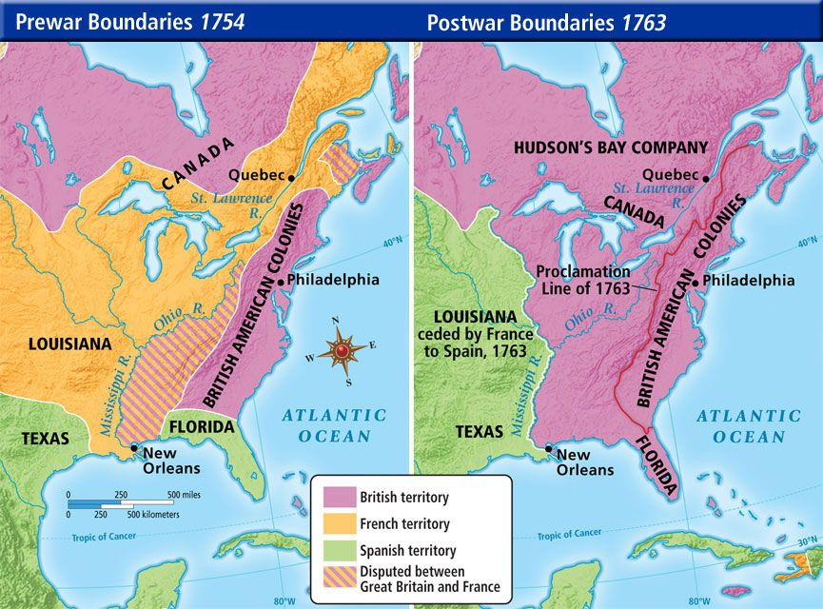
French and Indian War, Before and After
Initially, the war starts out poorly for Britain

Slide 6
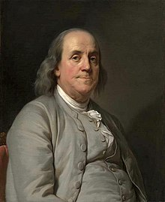
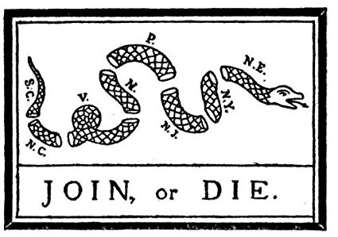
The Albany Plan
British goal-
War effort and colonial defense
Secure Native American (Iroquois) alliance
Bribery
Colonial unit against France
“Join, Or Die”
Only seven of thirteen colonies represented
Albany Plan
Accepted by all delegates
Rejected by individual colonies, London Regime
Too little vs. too much independence

Slide 7
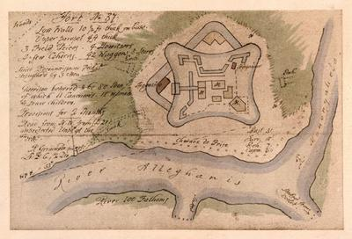
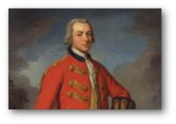
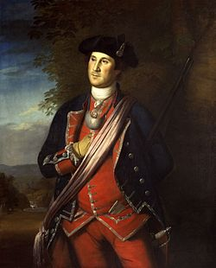
So, What Do I Need To Know About The War?
Start of war
Goes badly for Britain
General Edward Braddock
In VA with regulars
Off to capture Ft. Duquesne (1775)
Ill disciplined soldiers
Heavy equipment—moves slowly
Encounters with French, Indians
Washington involved in battle

Slide 8
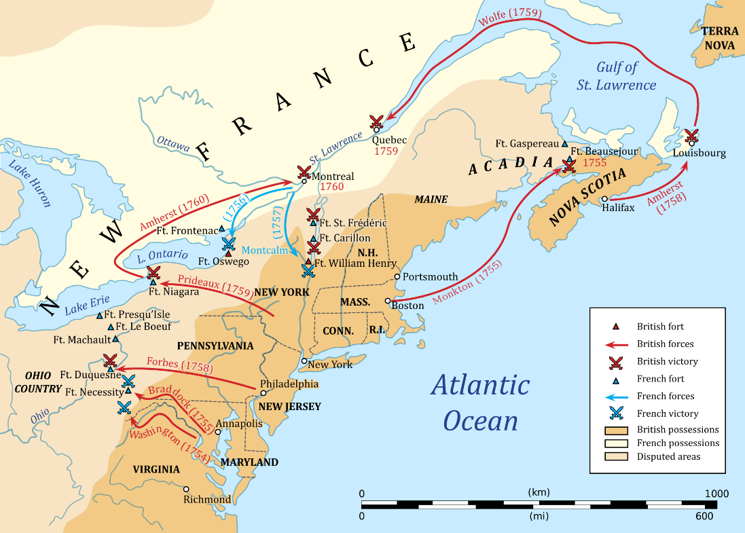
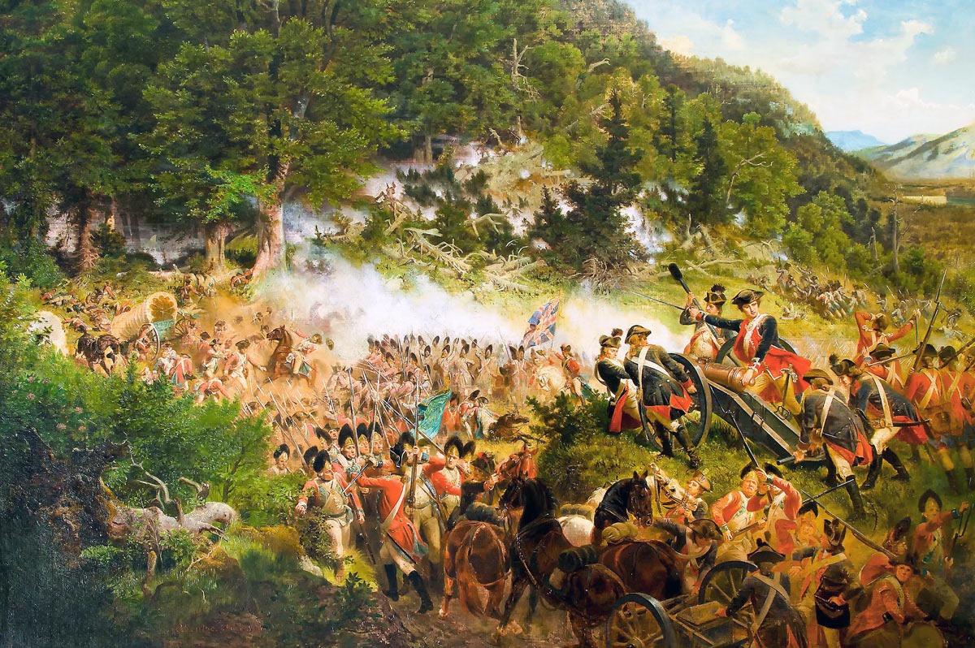
Indians Seize The Day & Britain’s Response
Indians move on
From PA to NC—wreak havoc on colonies
Bounties for Indian scalps
Washington attempts to defend the territory
Britain
Launches invasion of Canada—1756
Uncoordinated; no real target
Should have been Quebec and Montreal
Continue to suffer defeat

Slide 9
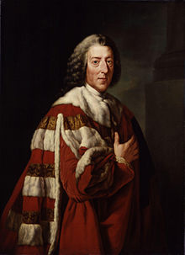
The Tides Turn
William Pitt—The Great Commoner
Will become known as the Organizer of Victory
A man of the people—he knew how to rally them
Gifted speaker
1757
Comes to the spotlight in London
Focuses attacks on Canada—Quebec and Montreal
Picked young, energetic leaders for battle

Slide 10
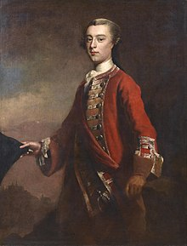
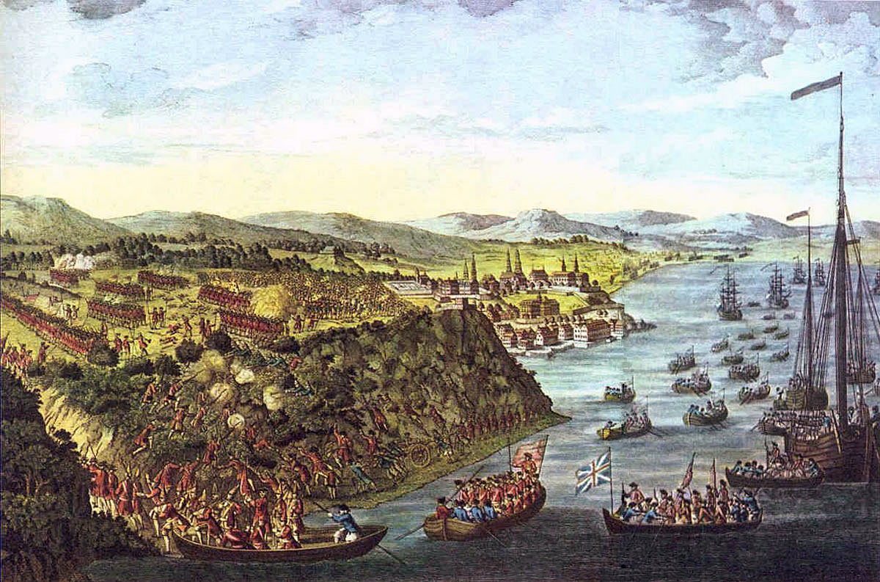
Pitt’s Leadership
First significant victory at Louisbourg, 1758
Powerful expedition attacks
Quebec--1759
Pitt looks to James Wolfe—an officer since the age f 14
Britain slow to move
Wolfe sends a unit up to a poorly guarded entrance to Quebec
Wolfe dies in battle—but Britain gains another victory
Battle of Quebec
Significant!
Montreal falls the following year
Leads to Peace agreement in 1763

Slide 11
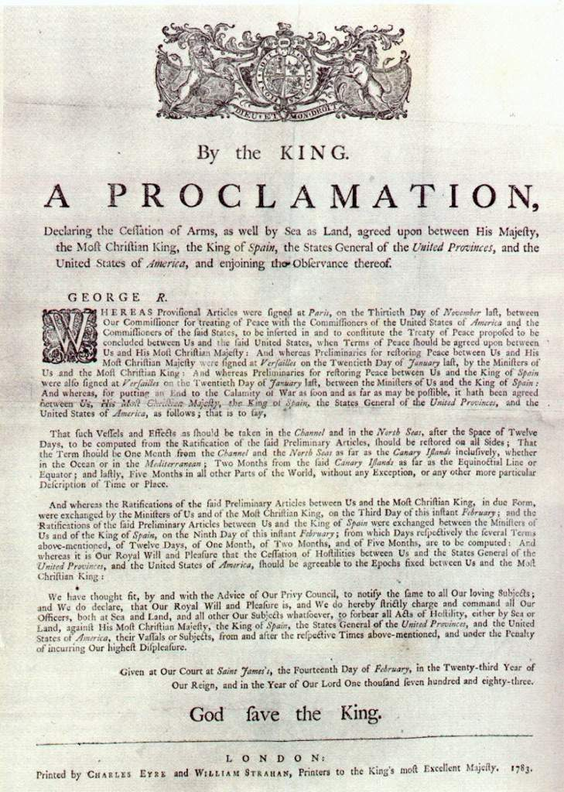
Big Picture
France loses foothold in Canada, North America
Still French roots in Canada
France allowed to keep some sugar islands as part of the peace
France cedes its American territory to Spain
Spain turns Florida over to Britain for Cuba
Britain now the dominant power in North America
Still a strong naval power, too

Slide 13
The War’s Aftermath
Colonists | Britain
Realized they could hold their own | No longer seen as “invincible”
Bolstered morale | Squashed Colonial’s attempts to rise up the ranks; look down on “failures”
Believed they deserved credit for British victory | Saw the colonists as “dogs” in battle
Smuggled goods to enemy territory during war | Banned the export of goods from NE and Middle Colonies
Demanded the right of Englishmen without responsibilities (taxes AND militia) of Englishmen | “Don’t bite the hand that feeds you”
Colonial disunity encouraged by geography—barriers, distance, religion, etc.
BUT—victory in war, as well as having to fight for that victory—played a role in unifying colonists.
Americans. Same Language. Same Ideals/Beliefs

Slide 14
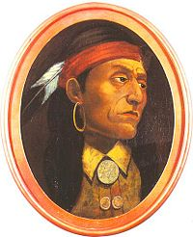
Clashes With Natives
France—out of the Picture
Spain—Limited in the Picture
Natives—still there!
No one to play off each other anymore
Deal solely with the British
1763—Ottawa Chief Pontiac
Led by French traders left behind
Try to oust British in Ohio territory

Slide 15
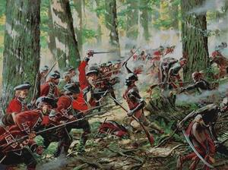
Pontiac’s Rebellion, 1763-1766
Unsuccessful attempt to oust British
British retaliate
Biological warfare
Outmaneuvered, out numbered, outgunned
Pontiac dies to a rival tribe years later
Britain wants to stabilize relations
How to do so?
Colonists reactions?

Slide 16
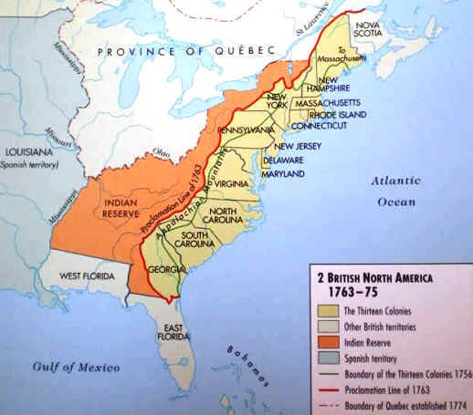
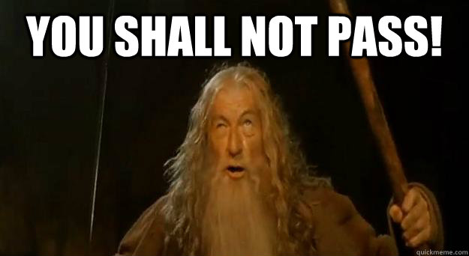
Proclamation Act of 1763—and its impact

Slide 17
Compare & Contrast: Contending Voices
“We do, with the advice of our Privy Council strictly enjoin and require, that no private person do presume to make any purchase from the said Indians of any lands reserved to the said Indians…but that, if at any time any of the said Indians should be inclined to dispose of the said lands, the same shall be purchased only for us [the British Crown], in our name…”
-Royal Proclamation of 1763
I can never look upon that Proclamation in any other light (but this I say between ourselves) than as a temporary expedient to quiet the minds of the Indians…Any person therefore who neglects the present opportunity of hunting out good lands and in some measure marking and distinguishing them for their own (in order to keep others from settling them) will never regain it.
-George Washington, 1767

